Slide 1
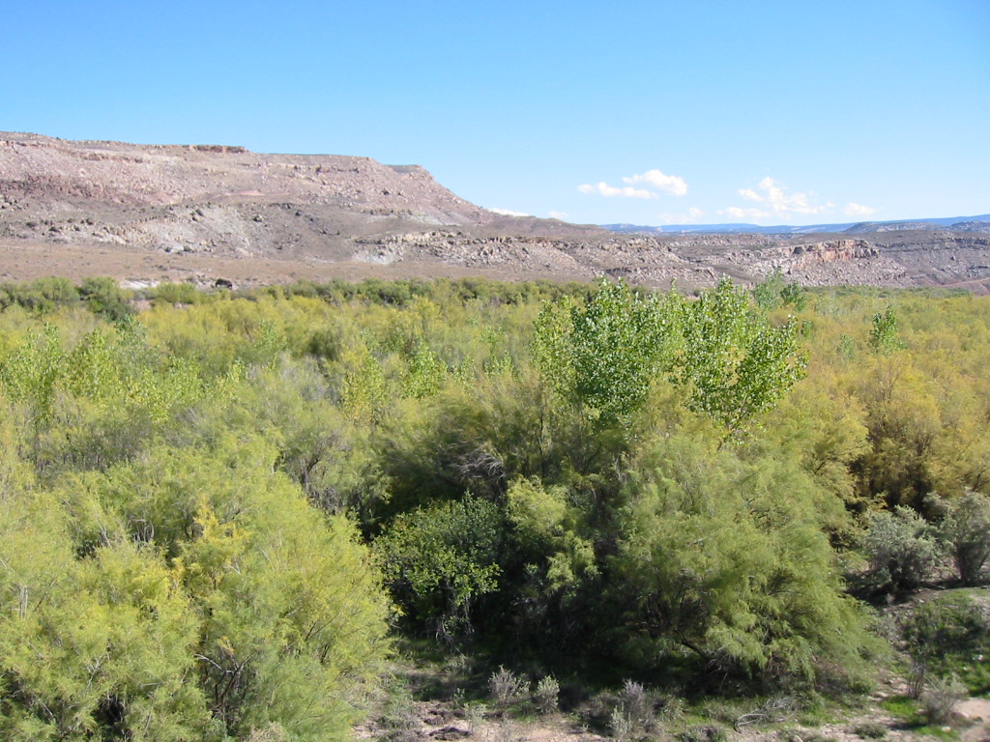
Automatic Assignment of Tamarisk Treatments
NR 505 Final Project
Ted Manahan and Patrick Flynn

Slide 2
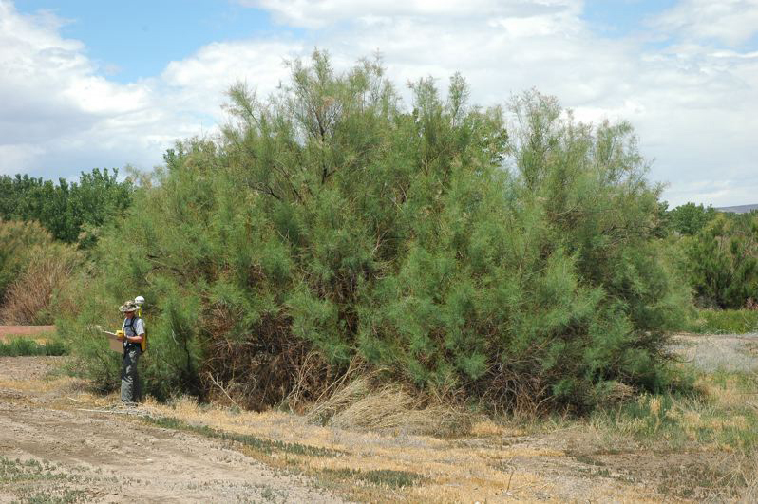
Tamarisk
Tamarisk or saltcedar is an invasive shrub or small tree
Crowds out native willow and cottonwood
Lowers water table
Image from http://www.oregonlive.com

Slide 3
Tamarisk Treatment Selection
We created a spacial model which assigns treatment types and generates a cost estimate for tamarisk control work for a specified geographic area.
The model selects appropriate tamarisk treatments based on accessibility, treatment type cost, and tamarisk infestation attributes such as density and size.
The estimate can inform the planning process, helping land managers understand the financial scope of a proposed tamarisk treatment project.

Slide 4
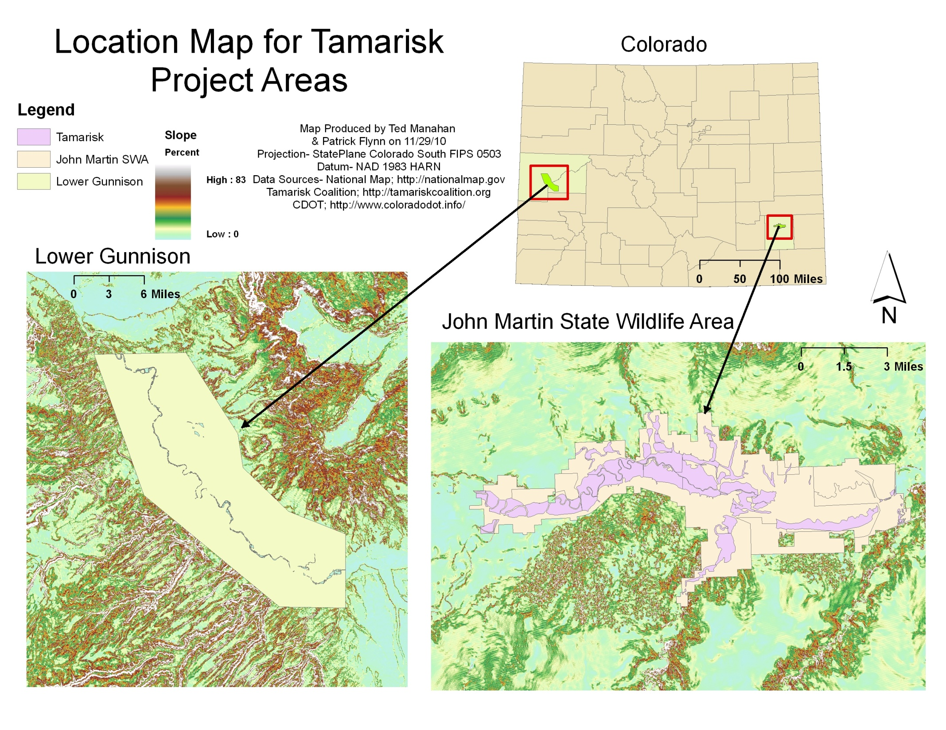

Slide 5
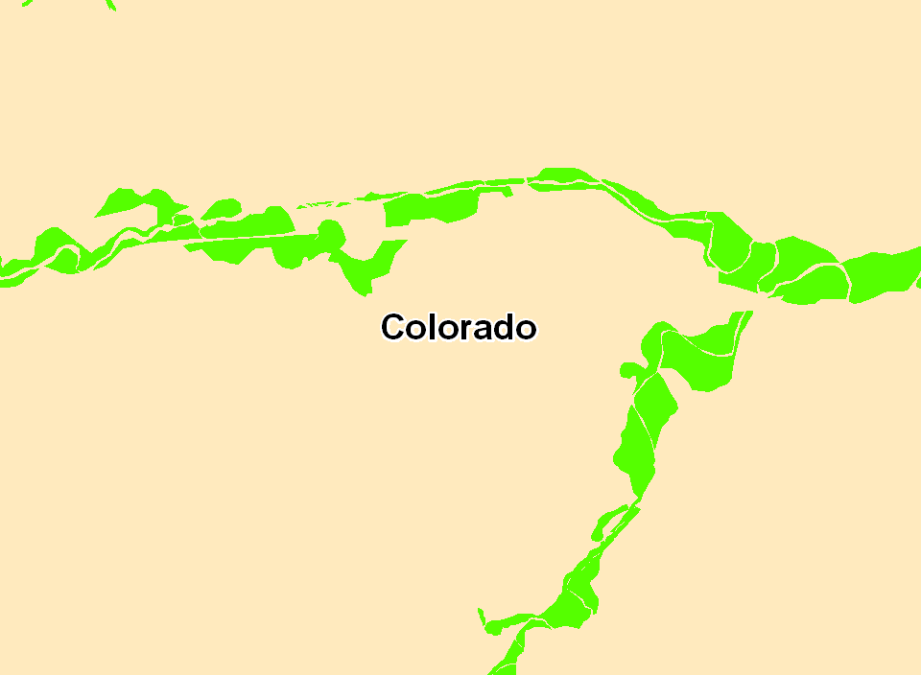
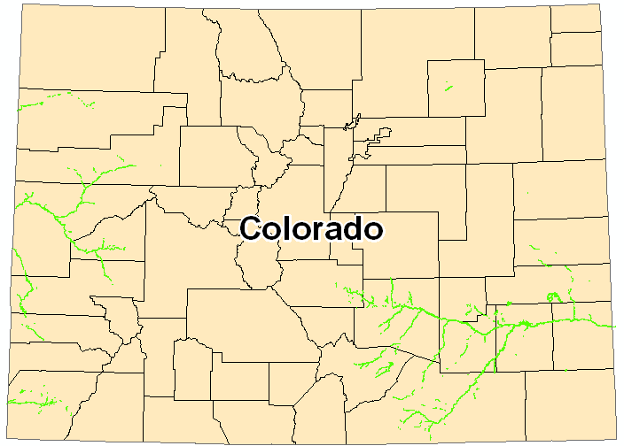
Base Map: Tamarisk Polygons

Slide 6
Base Map: Cost-Distance
John Martin SWA
Cost to nearest town
Travel cost is inexpensive on roads
Travel cost is expensive off roads
Treatment area is outlined in green

Slide 7
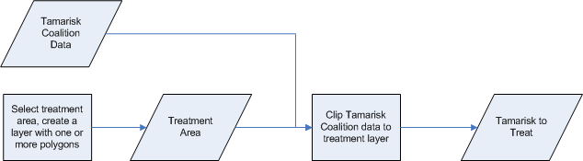
GIS Analysis: Select Treatment Area
Define treatment area as a layer
Clip tamarisk data to area

Slide 8
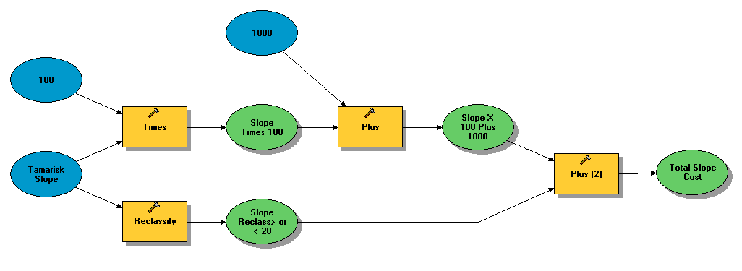
GIS Analysis: Cost Layer
Off-road cost calculated using a model
Penalize cost over steep terrain

Slide 9
GIS Analysis: Cost Layer
Road cost layer: 66- speed limit
Convert to GRID
Merge road cost and off-road cost layers using CON statement
con(isNull([roadcost]), [slopeCost], [roadCost])
Road Type | Speed limit
10 Primtive | 2
20 Unimproved | 5
30 Graded & Drained | 15
40 Soil, Gravel or Stone | 25
51-53 Bituminous | 35
61-62 Flexible | 45
71-72 Rigid | 50
80 Other | 55

Slide 10
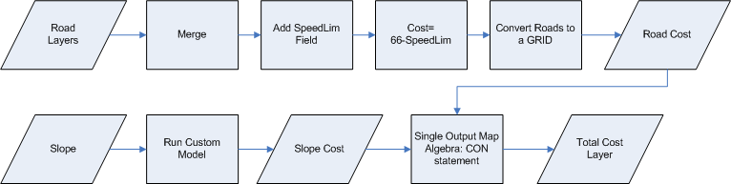
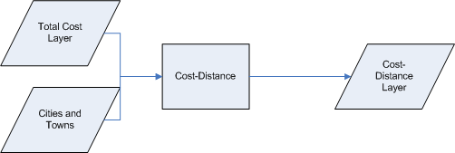
GIS Analysis: Cost Layer

Slide 11
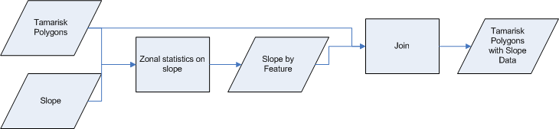
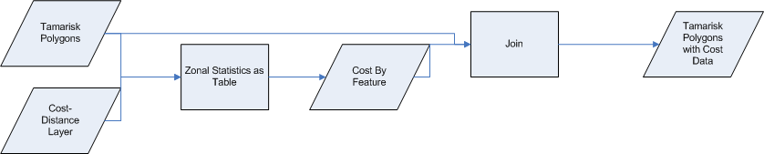
GIS Analysis: Tamarisk Attributes
Add slope and cost data to polygons
Create tables using Zonal Statistics as Table
Join tables to tamarisk polygons

Slide 12
GIS Analysis: Tamarisk Polygons
Export table to CSV file
Rename columns to standard values: VALUE, Pct_Cov, Area, SlopeMAX, CostMEAN
VALUE | Pct_Cov | AREA | SlopeMAX | CostMEAN
0 | 30 | 32245.52 | 1.040729 | 604639.9
1 | 40 | 534017.3 | 2.199281 | 792934.4
2 | 20 | 349195.4 | 11.87033 | 688089.4
3 | 30 | 176957.1 | 25.8956 | 1751321
4 | 10 | 64491.04 | 24.53129 | 2843566

Slide 13
GIS Analysis: Centroid Matrix
Need to know adjacent polygons
Use Zonal Geometry as Table to get centroids
Use Hawth’s Tools, create NxN distance matrix
UID | 0 | 1 | 2 | 3 | 4
0 |  | 821.2007 | 1885.36 | 3209.405 | 4230.862
1 | 821.2007 |  | 1067.987 | 2412.106 | 3415.427
2 | 1885.36 | 1067.987 |  | 1365.836 | 2347.449
3 | 3209.405 | 2412.106 | 1365.836 |  | 1089.061
4 | 4230.862 | 3415.427 | 2347.449 | 1089.061

Slide 14
GIS Analysis: Treatment Costs
Previous work created two CSV files:
  The file of tamarisk polygons, including slope and remoteness cost information
  The file of distances between polygon centriods
Create treatment cost CSV file manually
Treatment | Cost
Manual | 3000
Aerial | 1000
Mechanical | 2000

Slide 15
GIS Analysis: Assign Treatments
function AssignTreatment($TamariskPolygons, $TreatmentGroups)
{
global $MinPctCovForAerial;
global $MinAreaForAerial;
global $MaxSlopeForMechanical;
global $MinPctCovForMechanical;
// The number of polygons and treatment groups
$NumPolygons=count($TamariskPolygons);
$TGCount=count($TreatmentGroups);
echo "AssignTreatment: Assigning treatments for $NumPolygons polygons ".
"in $TGCount groups.\n";
// Aggregate treatment groups
//echo "AssignTreatment: Calling AggregateTGs from AssignTreatment\n";
$GroupAttrs=AggregateTGs ($TreatmentGroups, $TamariskPolygons);
// Assign treatment to groups
for ($GroupNo=0; $GroupNo<$TGCount; $GroupNo++) {
//echo "\tAssigning values for treatment group $GroupNo\n";
if (($GroupAttrs[$GroupNo]["Area"]>$MinAreaForAerial) &&
($GroupAttrs[$GroupNo]["Pct_Cov"]>$MinPctCovForAerial))
{
$GroupAttrs[$GroupNo]["Treatment"]="Aerial";
} else {
if (($GroupAttrs[$GroupNo]["SlopeMAX"]<=$MaxSlopeForMechanical) &&
($GroupAttrs[$GroupNo]["Pct_Cov"]>=$MinPctCovForMechanical))
{
$GroupAttrs[$GroupNo]["Treatment"]="Mechanical";
} else {
$GroupAttrs[$GroupNo]["Treatment"]="Manual";
}
}
}
// Dis-aggregate treatment groups
for ($TG=0; $TG<$TGCount; $TG++)
{
$NumPolysInTG=count($TreatmentGroups[$TG]);
for ($TGPoly=0;$TGPoly<$NumPolysInTG;$TGPoly++)
{
$Poly=$TreatmentGroups[$TG][$TGPoly];
$TamariskPolygons[$Poly]["Treatment"]=$GroupAttrs[$TG]["Treatment"];
}
Use custom PHP program
Minimize total treatment cost scaled by accessibility
Treatment assignment uses three rules:
  A polygon or group of polygons must have at least 75% cover and 250 acres to be eligible for aerial treatment
  A polygon or group of polygons must have at least 50% cover an no more than 20% slope to be eligible for mechanical treatment
  If neither aerial nor mechanical treatment can be used, manual treatment is prescribed

Slide 16
GIS Analysis: Group Polygons
function AssignTreatment($TamariskPolygons, $TreatmentGroups)
{
global $MinPctCovForAerial;
global $MinAreaForAerial;
global $MaxSlopeForMechanical;
global $MinPctCovForMechanical;
// The number of polygons and treatment groups
$NumPolygons=count($TamariskPolygons);
$TGCount=count($TreatmentGroups);
echo "AssignTreatment: Assigning treatments for $NumPolygons polygons ".
"in $TGCount groups.\n";
// Aggregate treatment groups
//echo "AssignTreatment: Calling AggregateTGs from AssignTreatment\n";
$GroupAttrs=AggregateTGs ($TreatmentGroups, $TamariskPolygons);
// Assign treatment to groups
for ($GroupNo=0; $GroupNo<$TGCount; $GroupNo++) {
//echo "\tAssigning values for treatment group $GroupNo\n";
if (($GroupAttrs[$GroupNo]["Area"]>$MinAreaForAerial) &&
($GroupAttrs[$GroupNo]["Pct_Cov"]>$MinPctCovForAerial))
{
$GroupAttrs[$GroupNo]["Treatment"]="Aerial";
} else {
if (($GroupAttrs[$GroupNo]["SlopeMAX"]<=$MaxSlopeForMechanical) &&
($GroupAttrs[$GroupNo]["Pct_Cov"]>=$MinPctCovForMechanical))
{
$GroupAttrs[$GroupNo]["Treatment"]="Mechanical";
} else {
$GroupAttrs[$GroupNo]["Treatment"]="Manual";
}
}
}
// Dis-aggregate treatment groups
for ($TG=0; $TG<$TGCount; $TG++)
{
$NumPolysInTG=count($TreatmentGroups[$TG]);
for ($TGPoly=0;$TGPoly<$NumPolysInTG;$TGPoly++)
{
$Poly=$TreatmentGroups[$TG][$TGPoly];
$TamariskPolygons[$Poly]["Treatment"]=$GroupAttrs[$TG]["Treatment"];
}
To meet minimum area requirement, polygons can be grouped
Group based on similar slope and coverage attributes
Groups of low-cost polygons can “steal” polygons from high-cost groups
Try multiple groupings, select lowest cost

Slide 17
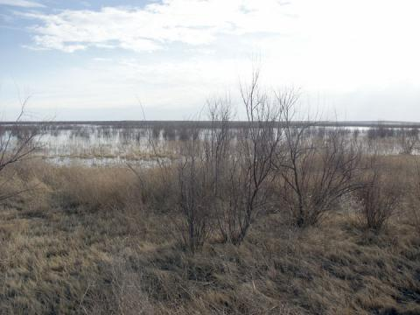
Results: John Martin SWA

Slide 18
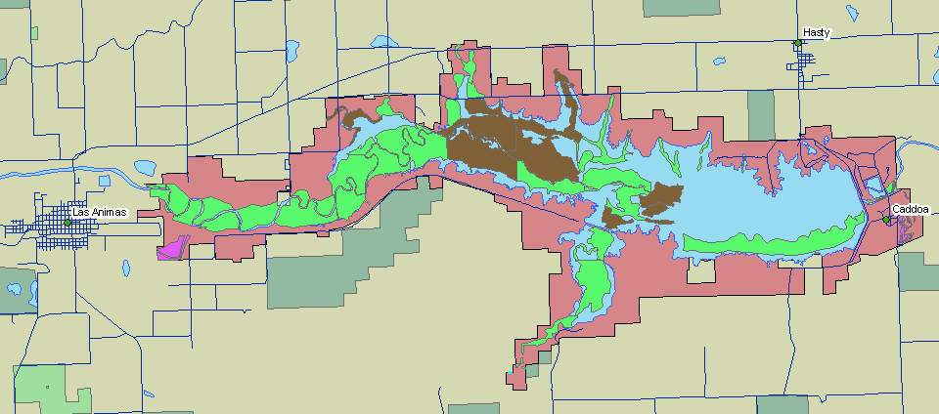
Results: John Martin SWA

Slide 19
Results: John Martin SWA
Unadjusted Treatment Cost: $11,676,764
Adjusted Treatment Cost: $11,893,358
Polygons have very similar accessibility
Group polygons to get enough area for aerial
Treatment Type | Total Area
Aerial | 2008 Acres
Mechanical | 4608 Acres
Manual | 142 Acres

Slide 20
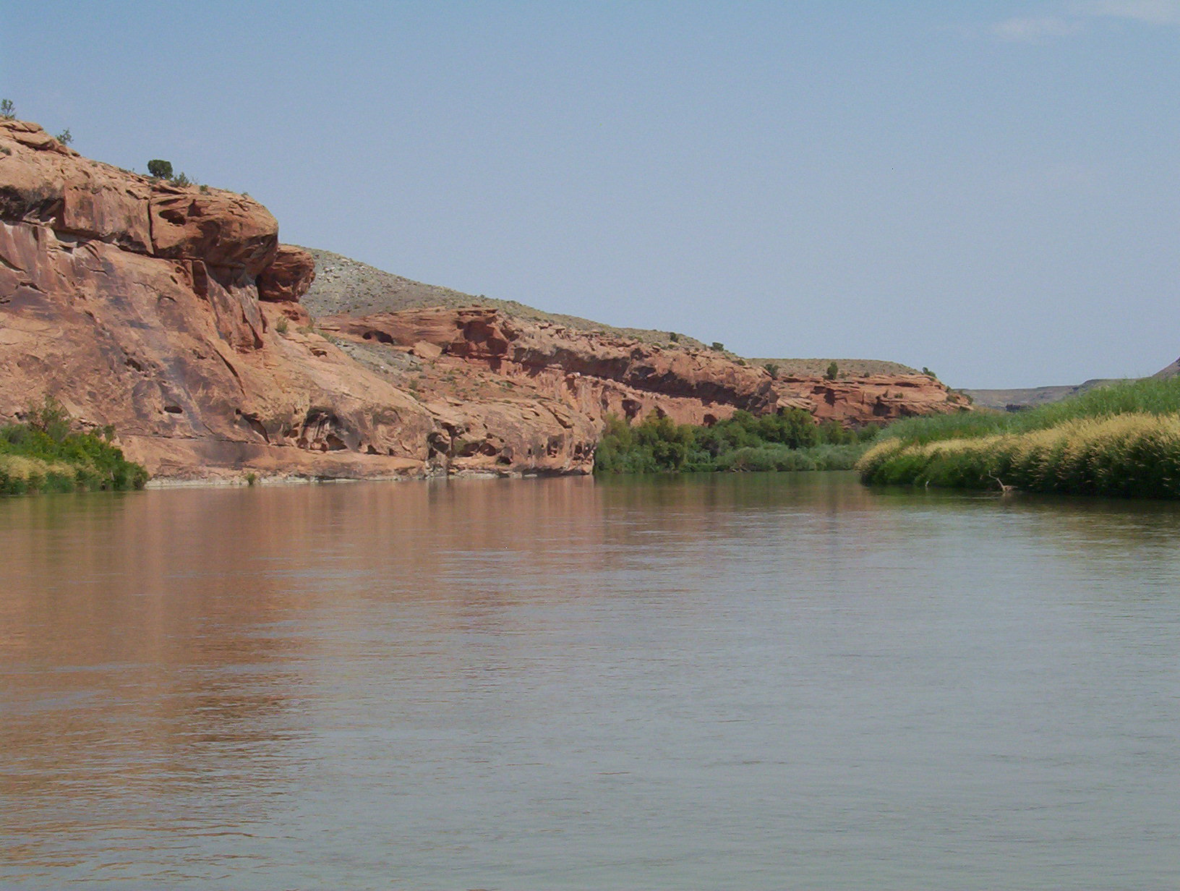
Results: Lower Gunnison River

Slide 21
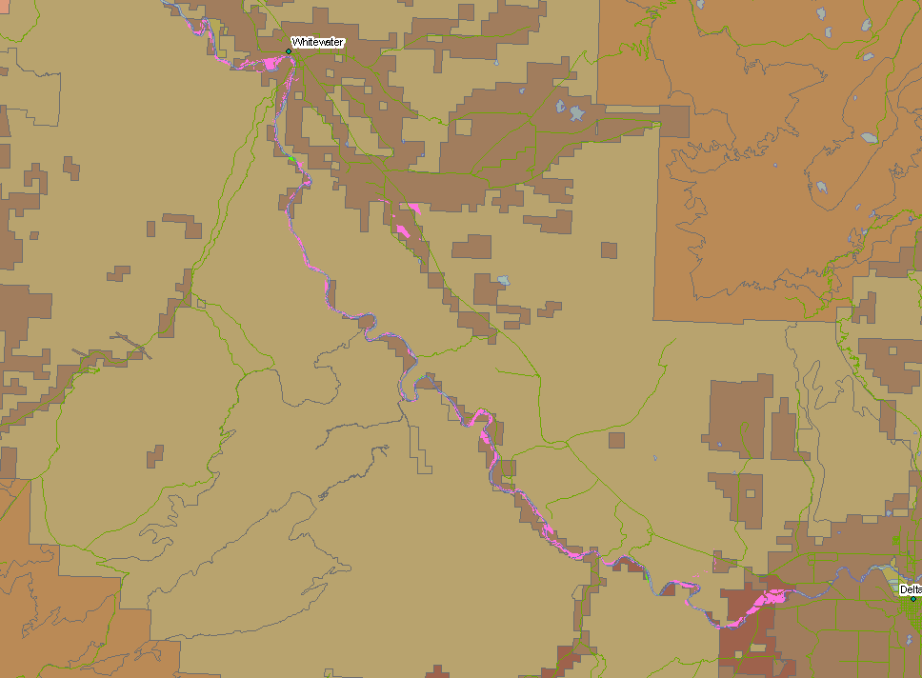
Results: Lower Gunnison River

Slide 22
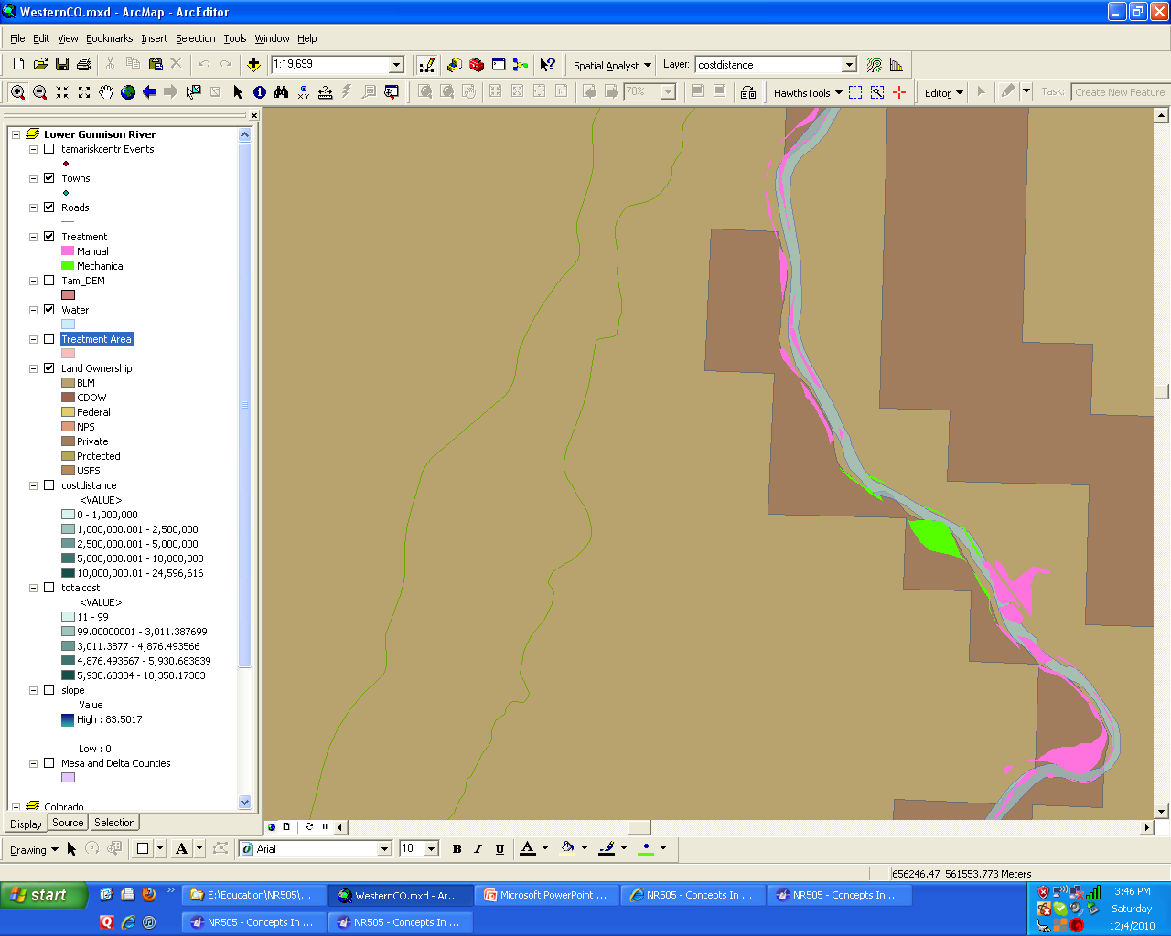
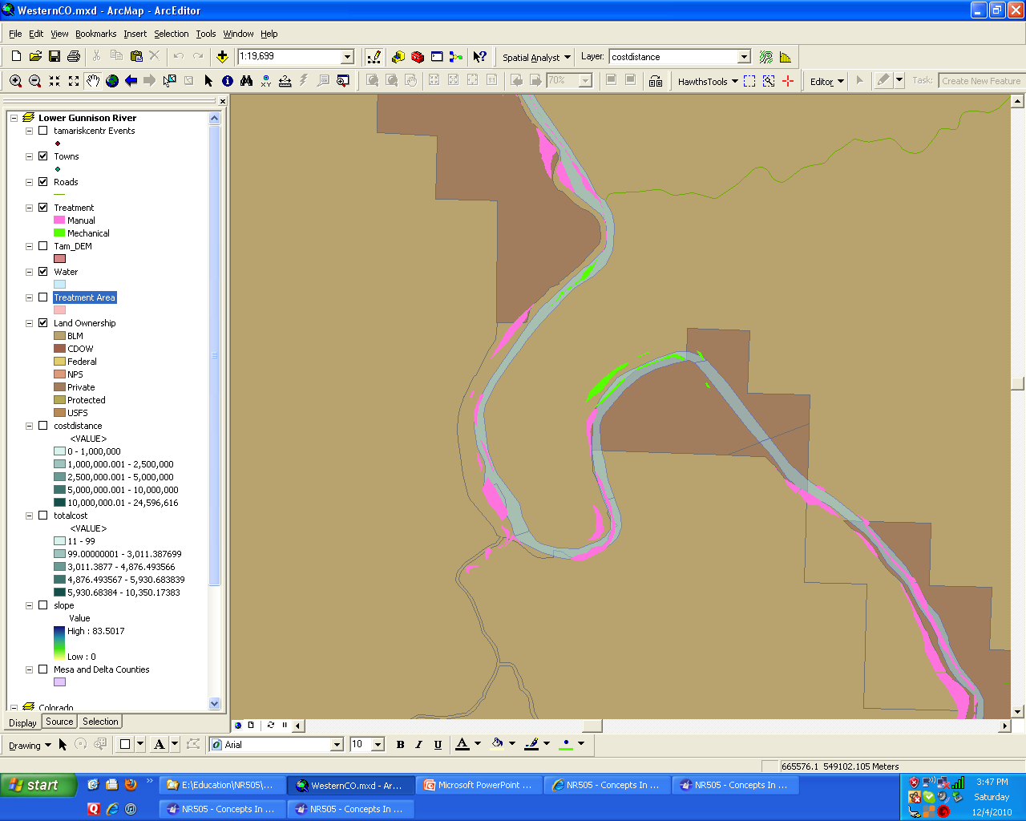
Results: Lower Gunnison River
Results: Lower Gunnison River

Slide 23
Results: Lower Gunnison River
Unadjusted Treatment Cost: $4,456,273
Adjusted Treatment Cost: $64,002,145
Polygons have different accessibility
Grouping does not affect treatment or cost
Treatment Type | Total Area
Aerial | 0 Acres
Mechanical | 29 Acres
Manual | 1466 Acres

Slide 24
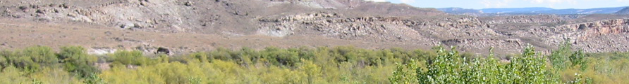
Conclusions
Preliminary treatment assignments are reasonable
Cost estimates may be too high; scaling by absolute accessibility may be better
Future improvements:
  More treatment types: biological (bugs!), multiple mechanical treatments, goats…
  Water as hard barrier

Slide 25
